Slide 1
Graph Data structures
Algorithms & Data Structures
ITCS 6114/8114
Dr. Dewan Tanvir Ahmed
Department of Computer Science
University of North Carolina at Charlotte

Slide 2
Graphs
1843
ORD
SFO
802
337
1743
LAX
1233
DFW

Slide 3
Outline and Reading
Graphs (§6.1)
Definition
Applications
Terminology
Properties
ADT

Slide 4
Graph
A graph is a pair (V, E), where
V is a set of nodes, called vertices
E is a collection of pairs of vertices, called edges
Vertices and edges are positions and store elements
Example:
A vertex represents an airport and stores the three-letter airport code
An edge represents a flight route between two airports and stores the mileage of the route
849
PVD
1843
ORD
SFO
142
802
LGA
337
1743
1387
HNL
2555
1099
LAX
1233
DFW
1120
MIA

Slide 5
Edge Types
Directed edge
ordered pair of vertices (u,v)
first vertex u is the origin
second vertex v is the destination
e.g., a flight
Undirected edge
unordered pair of vertices (u,v)
e.g., a flight route
flight
AA 1206
ORD
PVD
849
miles
ORD
PVD
Directed graph
all the edges are directed
e.g., flight network
Undirected graph
all the edges are undirected
e.g., route network

Slide 6
Applications
Electronic circuits
Printed circuit board
Transportation networks
Highway network
Flight network
Computer networks
Local area network
Internet
Databases
Entity-relationship diagram

Slide 7
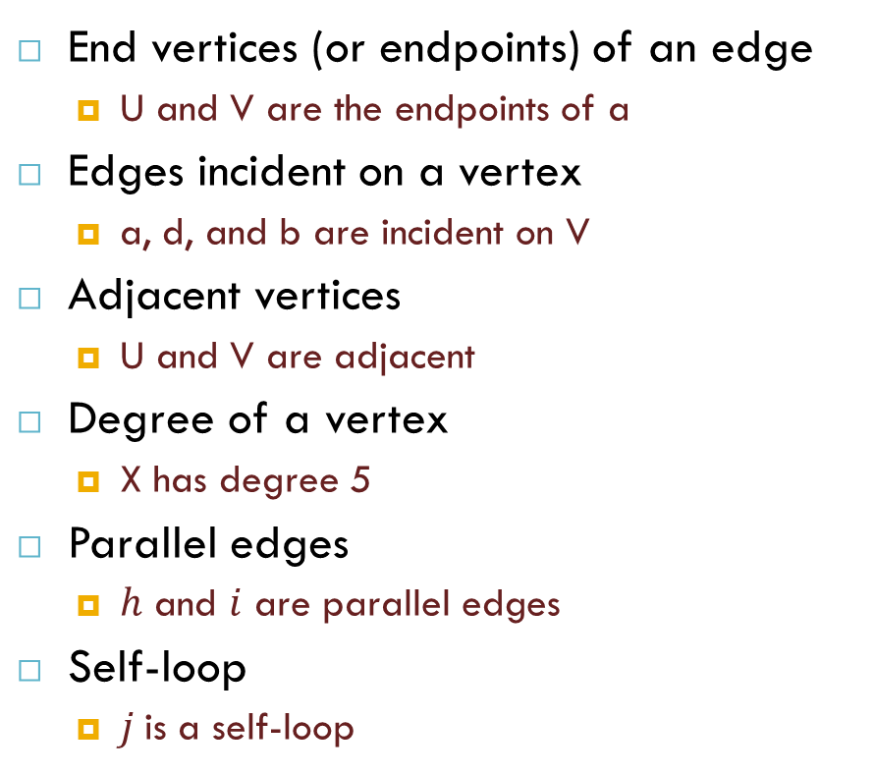
Terminology
End vertices (or endpoints) of an edge
U and V are the endpoints of a
Edges incident on a vertex
a, d, and b are incident on V
Adjacent vertices
U and V are adjacent
Degree of a vertex
X has degree 5
Parallel edges
$h$ and $i$ are parallel edges
Self-loop
$j$is a self-loop
V
a
b
h
j
U
d
X
Z
c
e
i
W
g
f
Y

Slide 8
Terminology (cont.)
Path
sequence of alternating vertices and edges
begins with a vertex
ends with a vertex
each edge is preceded and followed by its endpoints
Simple path
path such that all its vertices and edges are distinct
Examples
P₁=(V,b,X,h,Z) is a simple path
P₂=(U,c,W,e,X,g,Y,f,W,d,V) is a path that is not simple
V
a
b
P₁
d
U
X
Z
P₂
h
c
e
W
g
f
Y

Slide 9
Terminology (cont.)
Cycle
circular sequence of alternating vertices and edges
each edge is preceded and followed by its endpoints
Simple cycle
cycle such that all its vertices and edges are distinct
Examples
C₁=(V,b,X,g,Y,f,W,c,U,a,↵) is a simple cycle
C₂=(U,c,W,e,X,g,Y,f,W,d,V,a,↵) is a cycle that is not simple
V
a
b
d
U
X
Z
C₂
h
e
C₁
c
W
g
f
Y

Slide 10
Properties
Property 1
Σ_{v} deg(v) = 2m
Proof: each edge is counted twice
Property 2
In an undirected graph with no self-loops and no multiple edges
m ≤ n (n − 1)/2
Proof: each vertex has degree at most (n − 1)
What is the bound for a directed graph?
Notation
n number of vertices
m number of edges
deg(v) degree of vertex v
v
Example
n = 4
m = 6
deg(v) = 3

Slide 11
Main Methods of the Graph ADT
Vertices and edges
are positions
store elements
Accessor methods
endVertices(e): an array of the two endvertices of e
opposite(v, e): the vertex opposite of v on e
areAdjacent(v, w): true iff v and w are adjacent
replace(v, x): replace element at vertex v with x
replace(e, x): replace element at edge e with x
Update methods
insertVertex(o): insert a vertex storing element o
insertEdge(v, w, o): insert an edge (v,w) storing element o
removeVertex(v): remove vertex v (and its incident edges)
removeEdge(e): remove edge e
Iterator methods
incidentEdges(v): edges incident to v
vertices(): all vertices in the graph
edges(): all edges in the graph
Generic methods
numVertices()
numEdges()

Slide 12
Reference
Algorithm Design: Foundations, Analysis, and Internet Examples. Michael T. Goodrich and Roberto Tamassia. John Wiley & Sons.
Introduction to Algorithms. Thomas H. Cormen, Charles E. Leiserson, Ronald L. Rivest, Clifford Stein.

Slide 13
Thank you!

